Slide 1
Achieving Quality
UNIT 3

Slide 2

Reference
sites.google.com/view/snandagopalan

Slide 3
Agenda Achieving Quality…..
Introducing tactics
Availability tactics
Modifiability tactics
Performance tactics
Security tactics
Testability tactics
Usability tactics
Relationship of tactics to architectural patterns

Slide 4
Introducing tactics
The achievement of portability, high performance, and integrability depends upon design decisions.
A tactic is a design decision that influences the control of a quality attribute response.
A collection of tactics - architectural strategy.

Slide 5
Tactics are ways to get the desired response in a scenario
Tactic
Artifact
Stimulus
Response
Environment

Slide 6
Tactics example: performance
Introduce
concurrency
Max delay
< 2 sec
Database
25 req/sec
Prompt
results
Normal ops

Slide 7
Tactical Approaches to achieve--→
Availability
Modifiability
Performance
Security
Testability
Usability

Slide 8
(1) Availability Tactics
What is availability? Failure (system no longer delivers a service), Observable, A fault has the potential to cause a failure, Repair or Recover.
Its there already – OS, DBMS, Application Server, etc.

Slide 9
Fault Detection
Tactics for recognizing faults are:
Ping/echo. One component issues a ping and expects to receive back an echo, within a predefined time, from the component under scrutiny
Heartbeat (dead man timer). One component emits a heartbeat message periodically and another component listens for it. If the heartbeat fails, the originating component is assumed to have failed and a fault correction component is notified. Ex: ATMs
Exceptions. Raise an exception, exception handler

Slide 10
Fault Recovery
Voting. Processes running on redundant processors each take equivalent input and compute a simple output value that is sent to a voter.
Deviant behavior from a single processor, it fails it.
The voting algorithm can be "majority rules“
Ex: An element that occurs repeatedly for more than half of the elements of the input
A A A C C B B C C C B C C

Slide 11
Contd.
Clustering is the most common technique to achieve High availability for any services by introducing redundancy in software, hardware and data.
In a failure the clustering software immediately start the application on the standby system without requiring administrative intervention.

Slide 12
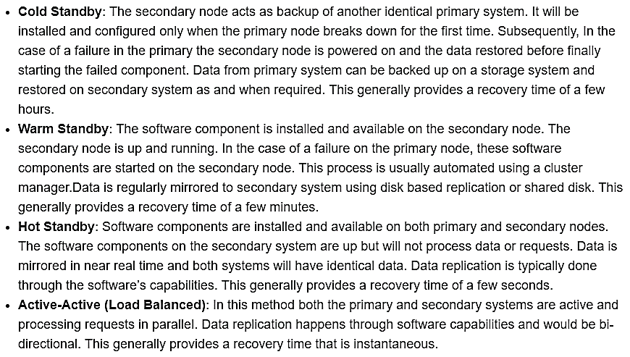
Recovery Methods

Slide 13
Contd.
Shadow operation. mimics the behavior of the working components before restoring it to service.
State resynchronization. Due to faulty hardware and OS bugchecks – it is possible that the primary and Replica Machines are not in sync.
Resynchronization (or Resync) is the process of re-establishing sync between primary and replica Virtual HDDs to have exactly the same data.
Checkpoint/rollback. Same as DBMS

Slide 14
Fault Prevention
Removal from service. Remove a component in case of anticipated failure. May be automatic or manual.
Transactions. Same as DBMS
Process monitor. Once a fault in a process has been detected, a monitoring process can delete the nonperforming process and create a new instance.

Slide 15
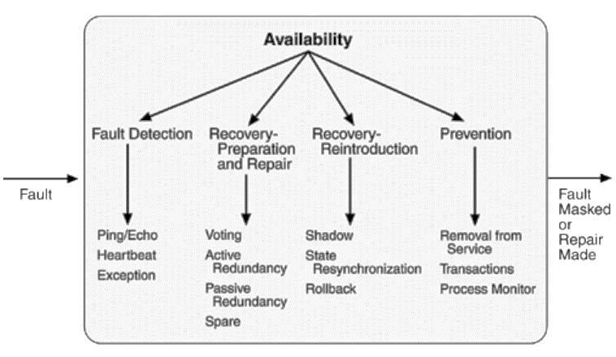
Summary of AT

Slide 16
(2) Modifiability Tactics
Control the time and cost to implement, test, and deploy changes.
localize modifications - Reducing the number of modules that are directly affected by a change
prevent the ripple effect - limiting modifications to the localized modules
defer binding time - control deployment time and cost

Slide 17
Localize Modifications
Maintain semantic coherence. Semantic coherence refers to the relationships among responsibilities in a module. The goal is to ensure that all of these responsibilities work together without excessive reliance on other modules.
Anticipate expected changes. Considering the set of envisioned changes provides a way to evaluate a particular assignment of responsibilities. Anticipating all changes is difficult in reality.
Generalize the module. Advantage: broader range of functions based on input
Limit possible options. Modifications, especially within a product line, may be far ranging and hence affect many modules. Restricting the possible options will reduce the effect of these modifications.

Slide 18
Prevent Ripple Effects
When Module A is changed, B also needs change because it depends on A.
Types of Dependencies (for B to execute correctly)
1. Syntax of data and service.
2. Semantics of data and service.
3. Sequence of data and control.
4. Identity of an interface of A
5. Location of A (runtime).
6. Quality of service/data provided by A.
7. Existence of A
8. Resource behaviour of A.

Slide 19
Defer Binding Time
Deployment of a system is dictated by -
When a modification is made by the developer, there is usually a testing and distribution process.
That is, the time lag between the making of the change and the availability of that change to the end user.
Binding at runtime means that the system has been prepared for that binding and all of the testing and distribution steps have been completed.

Slide 20
Runtime impact
Runtime registration supports plug-and-play operation – Ex: Publish/subscribe registration
Configuration files are intended to set parameters at startup.
Polymorphism allows late binding of method calls.
Component replacement allows load time binding.
Adherence to defined protocols allows runtime binding of independent processes

Slide 21
Summary of modifiability tactics

Slide 22
Agenda Achieving Quality…..
Availability tactics
Modifiability tactics
Performance tactics
Security tactics
Testability tactics
Usability tactics

Slide 23
(3) Performance Tactics
Generate a response to an event arriving at the system within some time constraint
Ex: arrival of a message, the expiration of a time interval, the detection of a significant change of state in the system's environment
The system processes the events and generates a response

Slide 24
Response Time
After an event arrives - system may process that event or is blocked for some reason.
Resource consumption.
CPU, data stores, network communication bandwidth, and memory, etc.
Ex: buffers must be managed and access to critical sections must be made sequential
Blocked time.
contention for it, because the resource is unavailable, or waiting for some other process

Slide 25
Resource Tactics
Resource Demand
Resource Management
Resource Arbitration

Slide 26
Resource Demand
One tactic for reducing latency is to reduce the resources required for processing an event stream
Reducing latency is to reduce the resources
Increase computational efficiency
Reduce computational overhead
Reducing latency is to reduce the number of events
Manage event rate
Control frequency of sampling
Controlling the use of resources
Bound execution times
Bound queue sizes

Slide 27
Resource Management
Introduce concurrency. If requests can be processed in parallel, the blocked time can be reduced.
Maintain multiple copies of either data or computations. Clients in a client-server pattern are replicas of the computation. The purpose of replicas is to reduce the contention that would occur if all computations took place on a central server.
Increase available resources. Faster processors, additional processors, additional memory, and faster networks all have the potential for reducing latency.

Slide 28
Resource Arbitration
An arbiter is a centralized place that knows whether the resource is in use or not.
Whenever there is a contention for a resource, the resource must be scheduled.
Ex: Processors, buffers, and networks
Same as DBMS Concurrency Control
First-in/First-out. FIFO queues treat all requests for resources as equals and satisfy them in turn
Fixed-priority scheduling. assigns each source of resource requests a particular priority and assigns the resources in that priority order
Dynamic priority scheduling: Round-robin, earliest deadline first.
Static scheduling: scheduling is determined offline

Slide 29
Summary of performance tactics

Slide 30
(4) Security Tactics
Tactics for achieving security can be divided into
resisting attacks
detecting attacks
recovering from attacks

Slide 31
Resisting Attacks
Authenticate users. Authentication is ensuring that a user or remote computer is actually who it purports to be. Passwords, OTP, digital certificates, and biometric identifications provide authentication.
Authorize users. Authorization is ensuring that an authenticated user has the rights to access and modify either data or services.
Maintain data confidentiality. Data should be protected from unauthorized access. Confidentiality is usually achieved by applying some form of encryption to data and to communication links. Aadhar, FB, etc.
Maintain integrity. Data should be delivered as intended. It can have redundant information encoded in it, such as checksums or hash results, which can be encrypted either along with or independently from the original data.

Slide 32
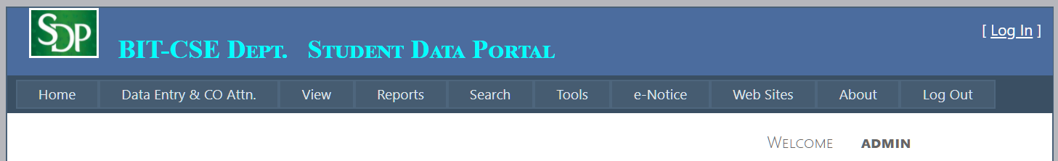
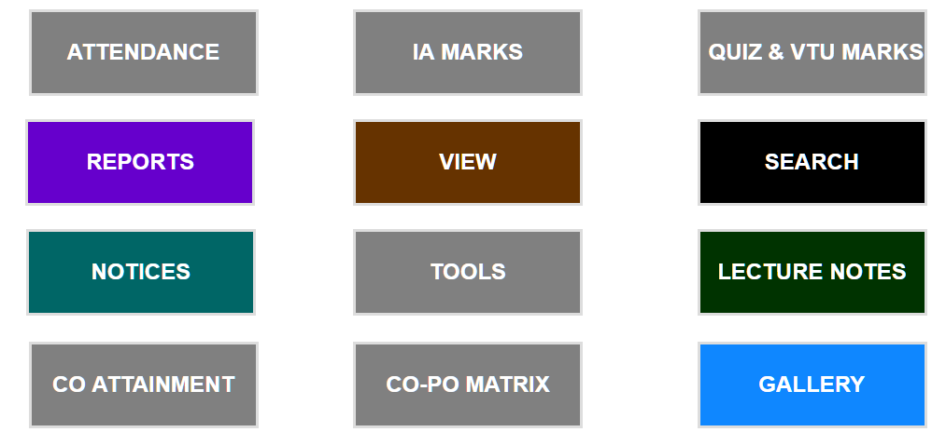
Contd.
Limit exposure. single weakness to attack all data and services on a host. Limit allocation of services to hosts - so only limited services are available.
Ex: SDP
Limit access. Firewalls.

Slide 33
Detecting Attacks
Detection - through an intrusion detection
Find the pattern of network usage. Any mismatch is an attack (signature)
Intrusion detectors must have
sensor to detect attacks
managers to do sensor fusion
databases for storing events for later analysis
tools for offline reporting and analysis
Dashboard / control console

Slide 34
Recovering from Attacks
Restoring state
Recovering from inconsistent to consistent state
Identifying an attacker
Maintain audit trail
Audit trails are often attack targets themselves and therefore should be maintained in a trusted fashion.

Slide 35
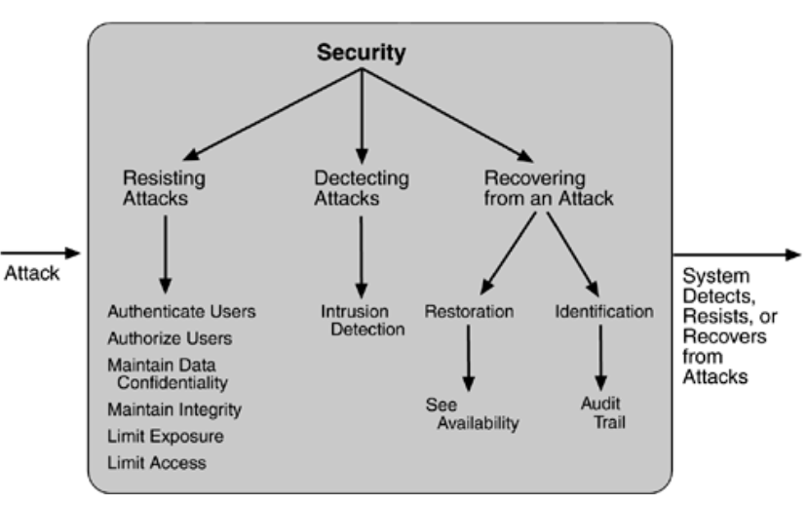
Summary of tactics for security

Slide 36
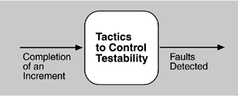
(5) Testability Tactics
Testability - allow for easier testing when software development is completed.
Testing takes huge amount of money!
The goal of a testing is to discover faults
Test harness – software to provide input and capture the output
Providing input and capturing output

Slide 37
Test harness
Same as the stimulator you might have done for performance
Automates some aspect of testing
But, for finding errors, the test cases need to be more complete (unless performance / reliability are what you’re testing!)
Can be for internal classes, etc., as well as external
Give this itself an “architecture” with options, different modes, etc.

Slide 38
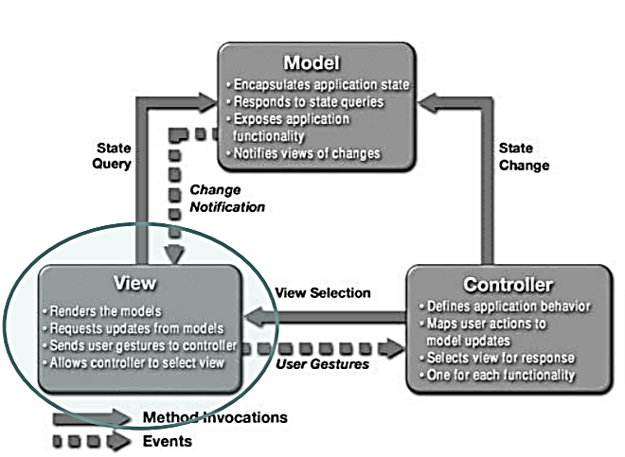
Example - MVC
Replace with stimulator, for testing

Slide 39
INPUT/OUTPUT
Tactics for managing input and output for testing
Record/playback.
Refers to both capturing information crossing an interface and using it as input into the test harness.
The information crossing an interface during normal operation is saved in some repository and represents output from one component and input to another.
Separate interface from implementation
Specialize access routes/interfaces

Slide 40
Internal Monitoring
A component can implement tactics based on internal state to support the testing process.
Built-in monitors
The component can maintain state, performance load, capacity, security, or other information accessible through an interface (permanent/temporary).
Monitoring states can actually increase the testing effort since tests may have to be repeated with the monitoring turned off.

Slide 41
Summary of testability tactics

Slide 42
(6) Usability Tactics
Usability is concerned with how easy it is for the user to accomplish a desired task and the kind of support the system provides to the user
User Interface design
Runtime

Slide 43
Runtime Tactics
Error correction and other efficient operations:
Ex: cancel, undo, aggregate, and show multiple views
human–computer interaction have used the terms
"user initiative"
"system initiative"
"mixed initiative“
Example:
“Cancel” - user imitative
“Progress bar” – system initiative
Mixed initiative

Slide 44
Cancel…
When the user takes the initiative, the architect designs a response. How?
The system must be listening for it - constant listener
not blocked by the actions of whatever is being canceled
Any resources being used by the canceled command must be freed
Components that are collaborating with the canceled command must be informed

Slide 45
System initiative
Maintain a model of the task. The task model is used to determine context so the system can have some idea of what the user is attempting and provide various kinds of assistance.
Example: Change lower-case to upper-case for any sentence’s beginning letter.
Maintain a model of the user. It determines the user's knowledge of the system, the user's behavior in terms of expected response time, and other aspects specific to a user or a class of users.
Example: maintaining a user model allows the system to pace scrolling so that pages do not fly past faster than they can be read.
Maintain a model of the system. It determines the expected system behavior so that appropriate feedback can be given to the user. The system model predicts items such as the time needed to complete current activity.

Slide 46
Design-time Tactics
User interfaces are typically revised frequently during the testing process
Separate the user interface from the rest of the application
Software architecture patterns developed to implement this tactic is:
Model-View-Controller
Presentation-Abstraction-Control
Seeheim (Resulted from the 1st UI software tools workshop held @ Seeheim, Germany. Nov 1-3, 1983.)
Arch/Slinky

Slide 47
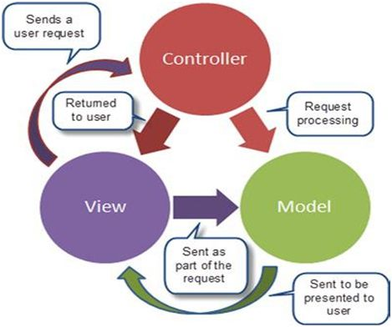
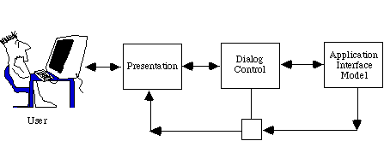
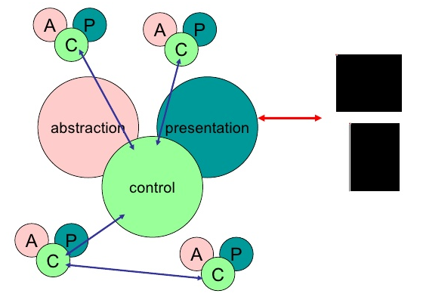
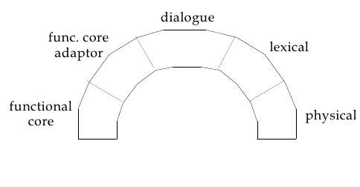
Seeheim
MVC
PAC
Arch/Slinky

Slide 48
Summary of runtime Usability tactics

Slide 49
Summary

